Slide 1
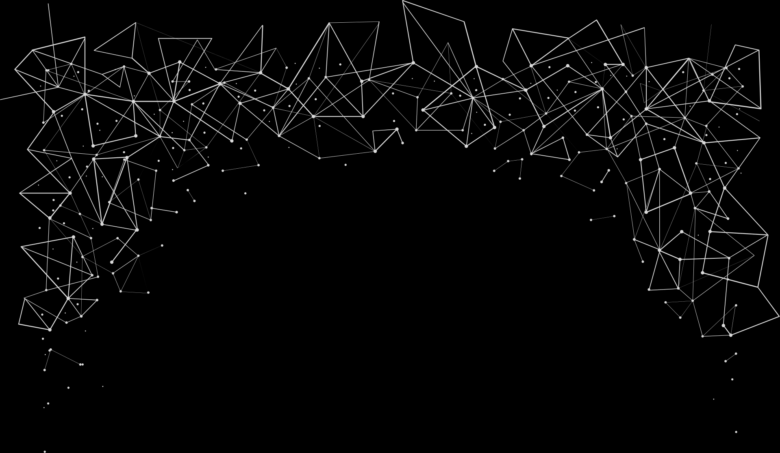
Parallel Graph Analytics with GUI in Java
Dima Azzam & Maryam Farhat
Presented to: Dr. Mohamad Aoude

Slide 2
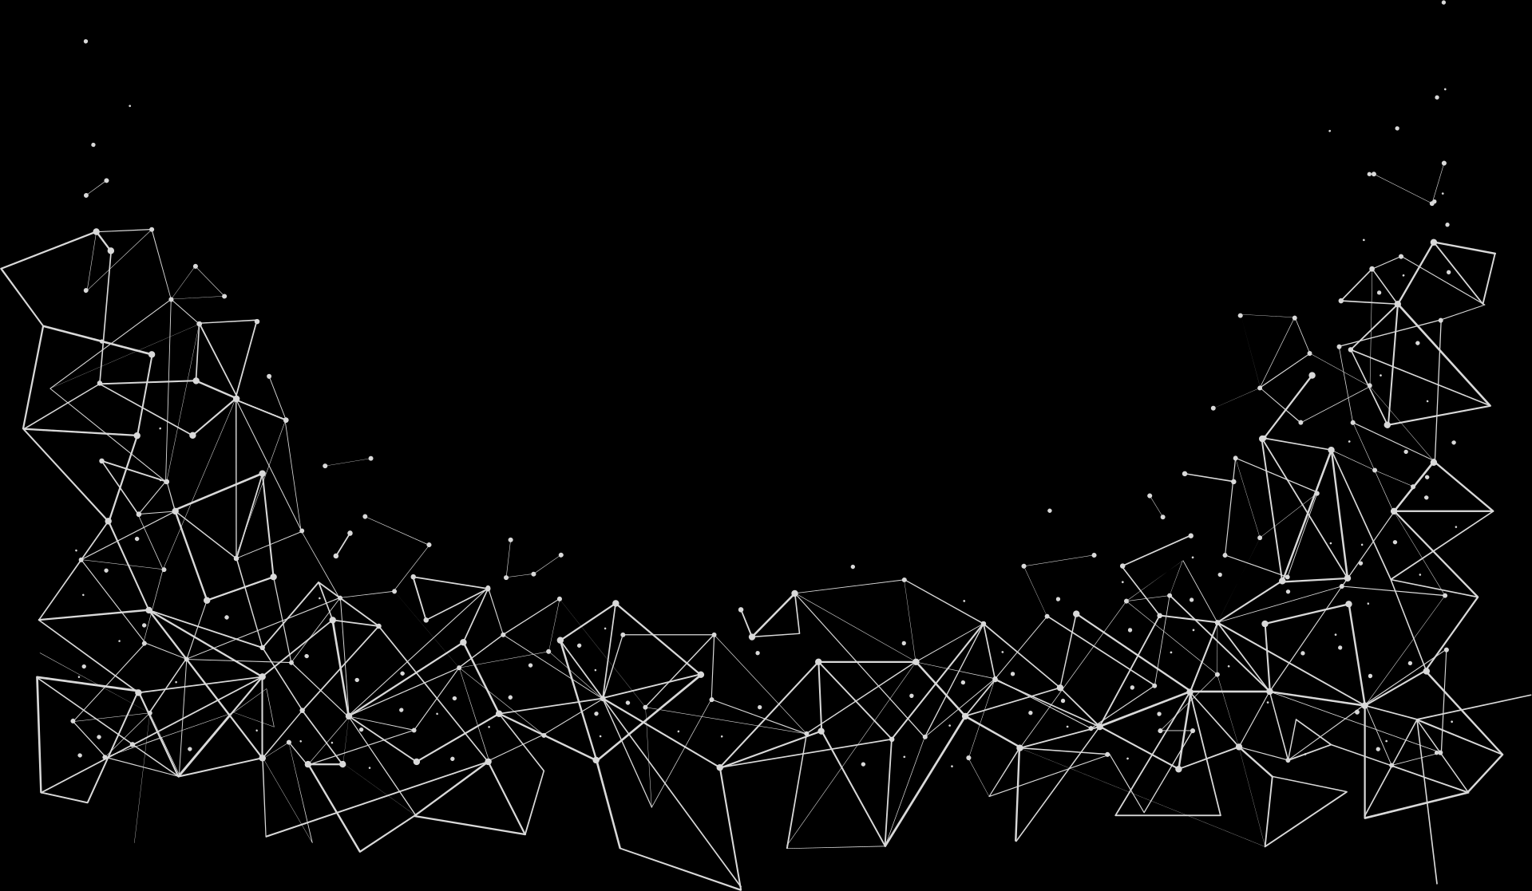
1
Problem Statement
Graph processing is computationally intensive but essential for various domains (social networks, transportation, computer networks, etc.).

Slide 3
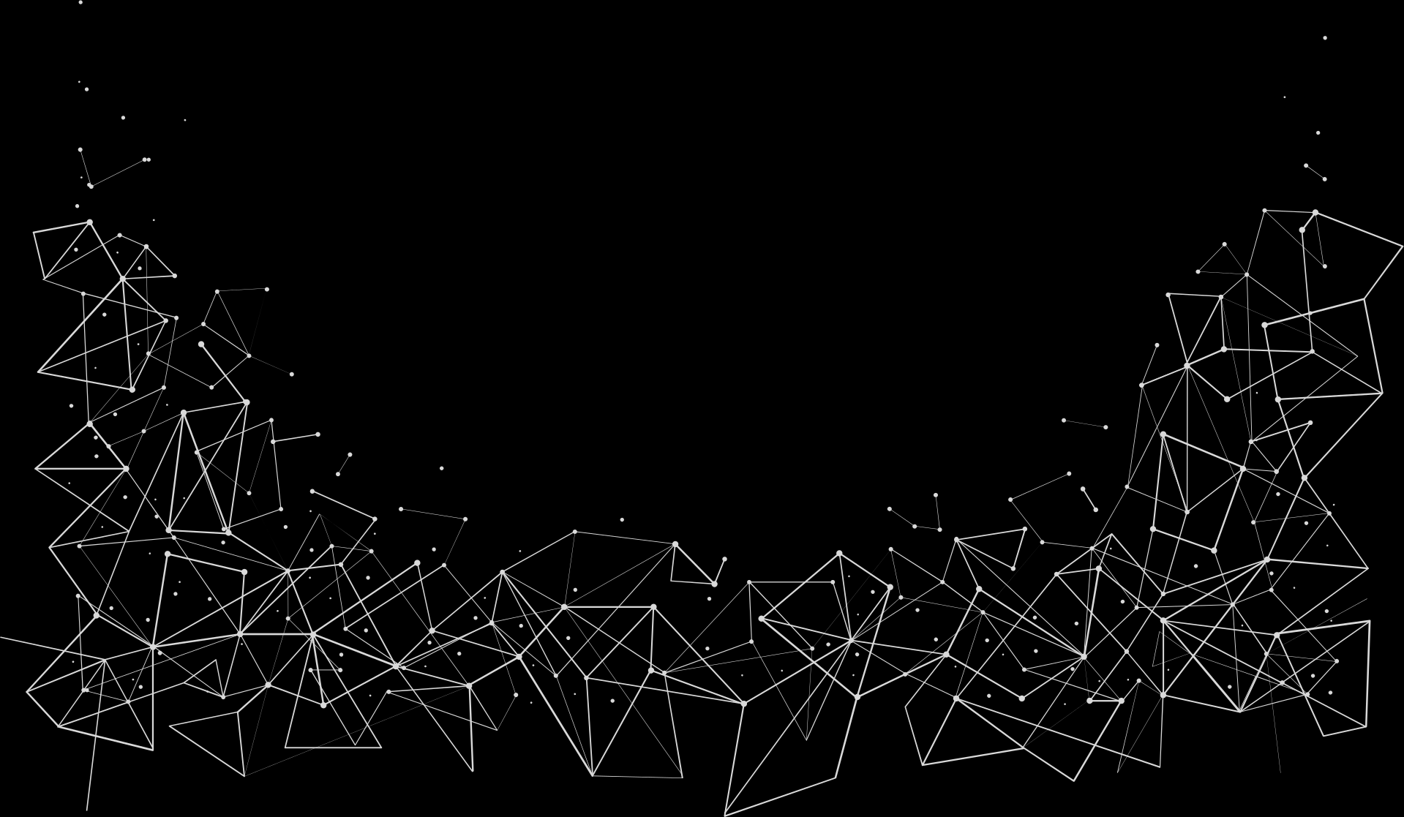
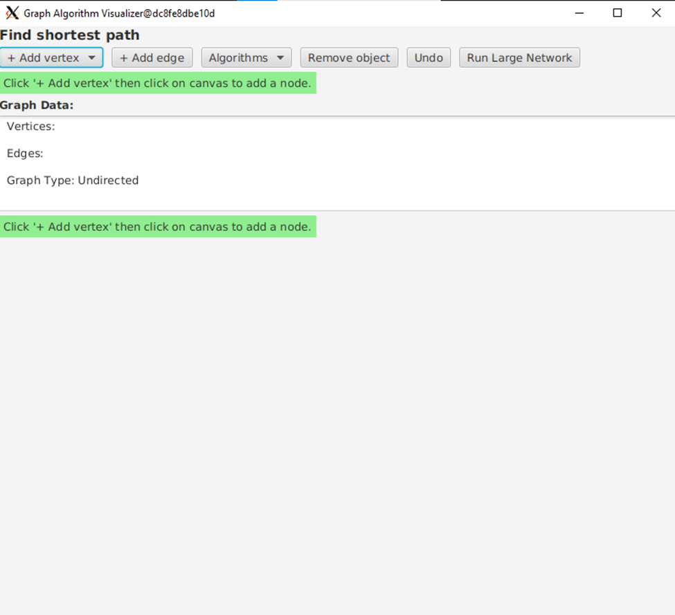
solution
Implement and parallelize key graph algorithms with a GUI for real-time visualization.
Goal: Speed up graph algorithms and make them user-friendly.

Slide 4
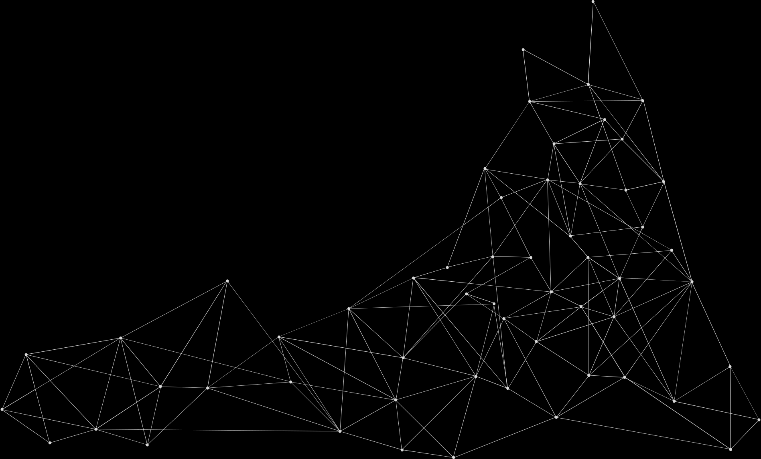
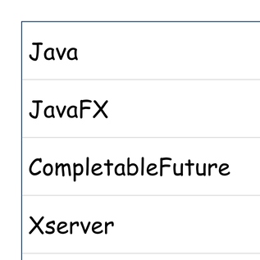
Technologies Utilized

Slide 5
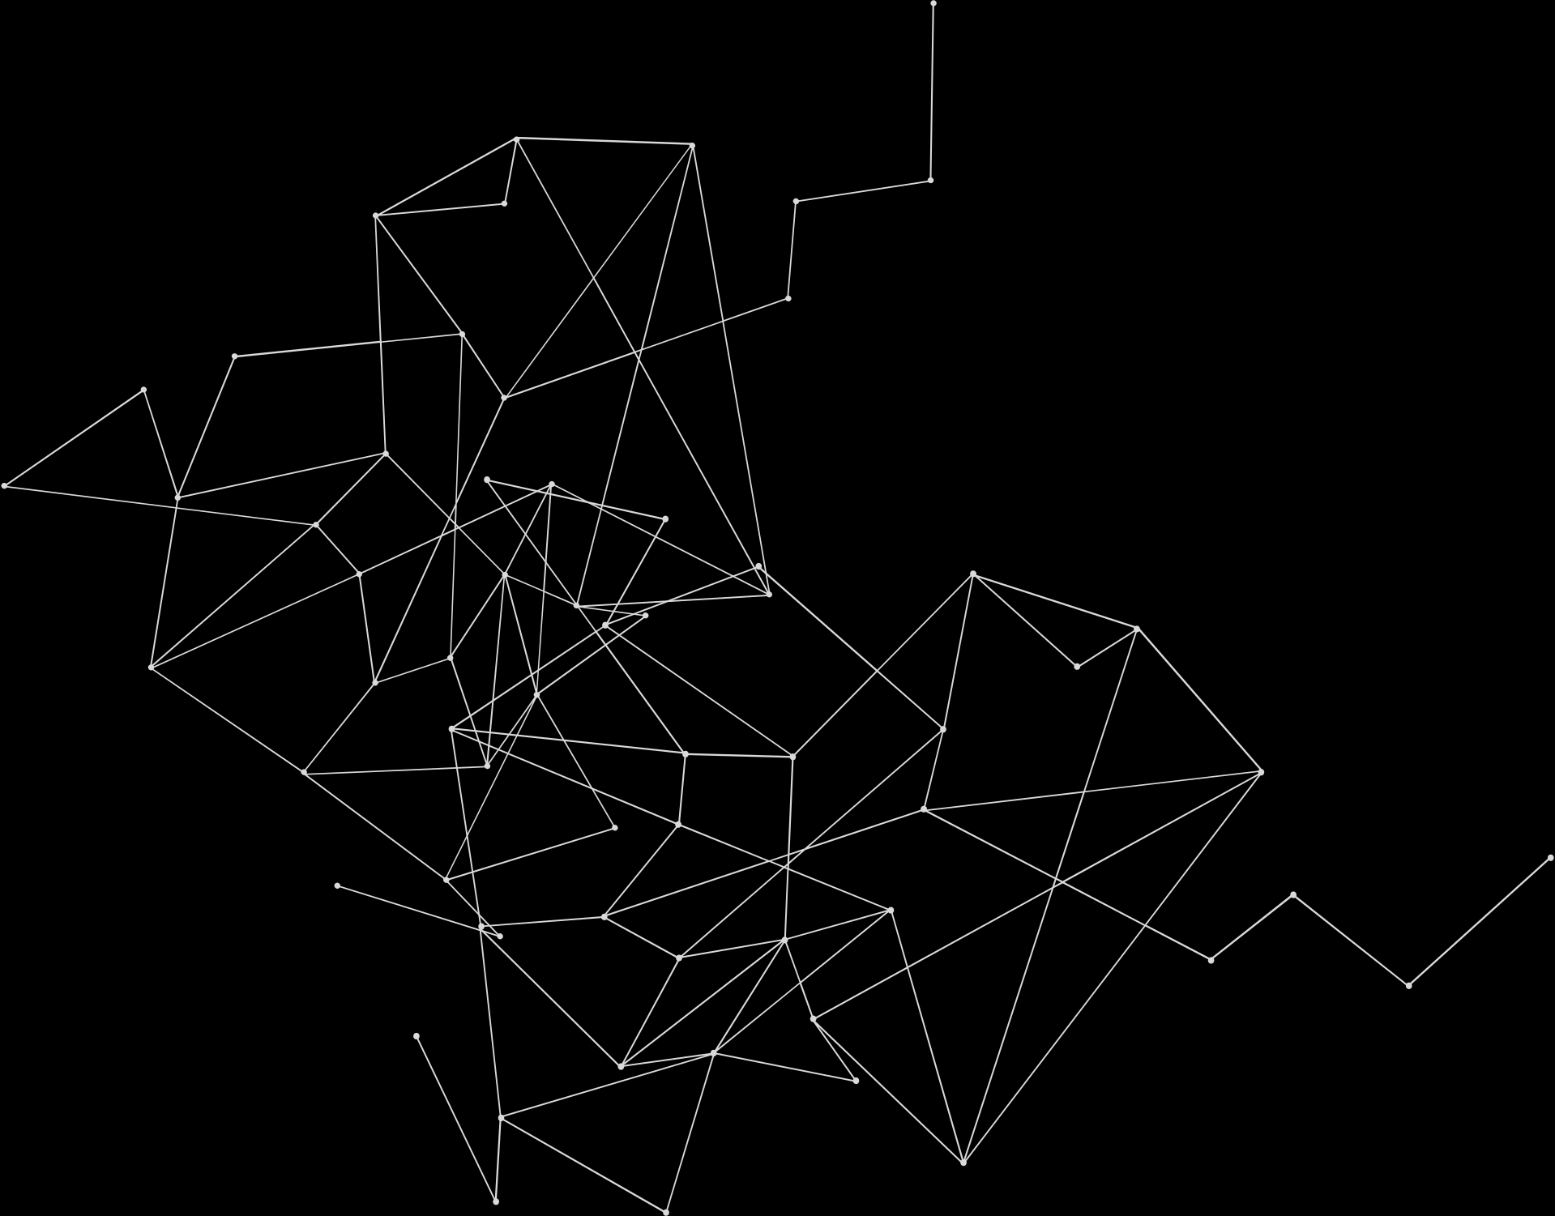
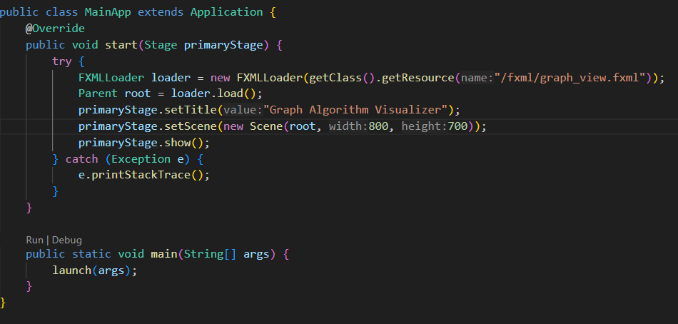
MainApp.java
What it Does:
Opens the window and loads the GUI.
Connects to Controller.java for interaction.

Slide 6
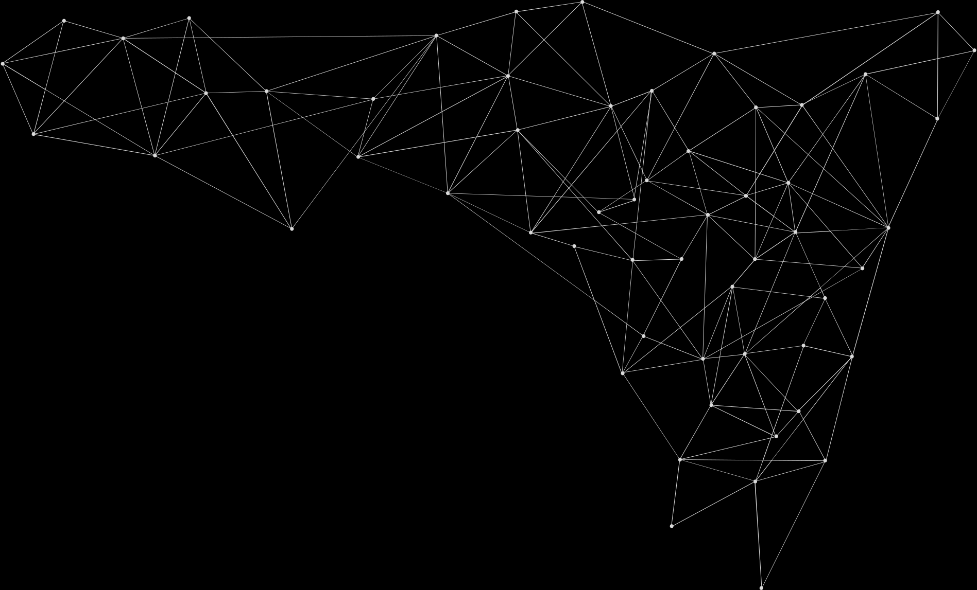
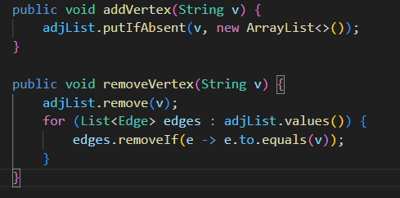
Graph.java
(responsible for storing nodes and edges)
Methods:
addVertex(),
addEdge(),
removeVertex(), etc.
Purpose: To build the graph that algorithms will work on.

Slide 7
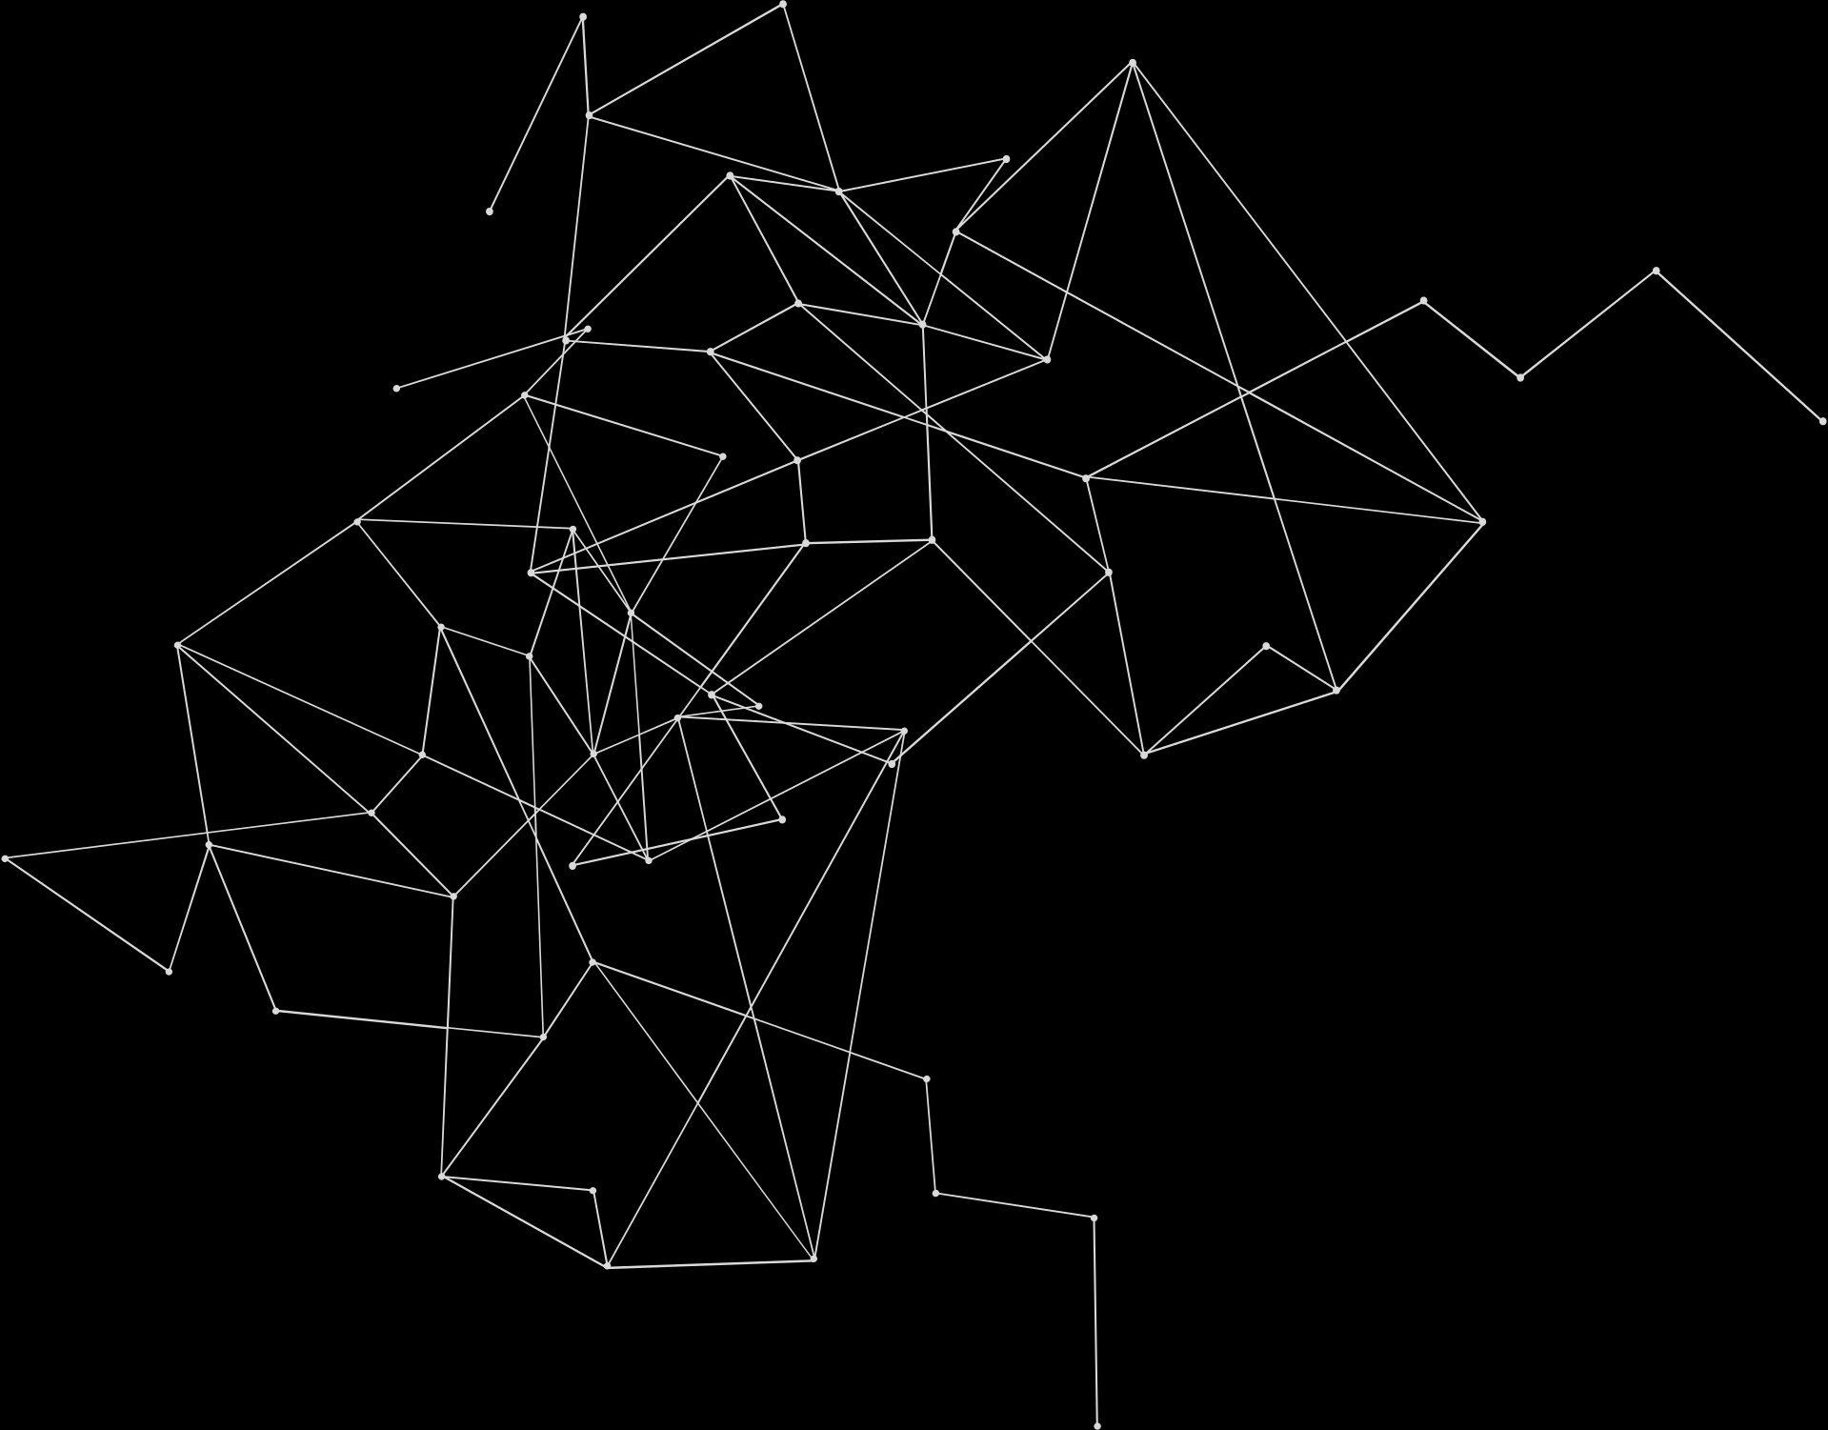
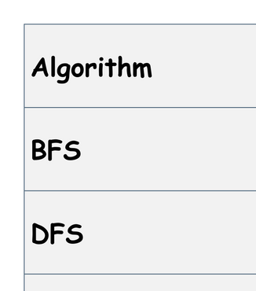
GraphAlgorithms.java

Slide 8
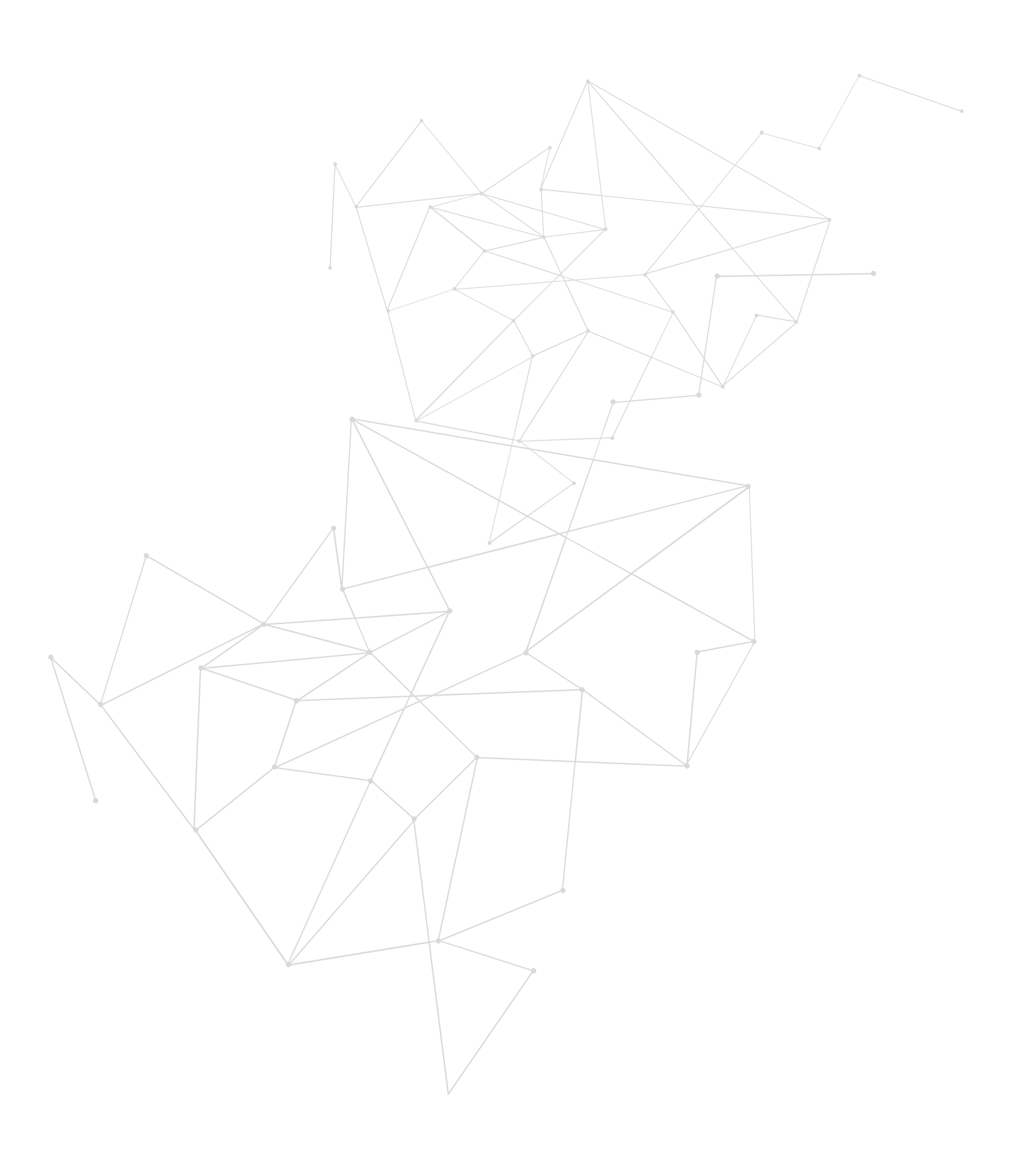
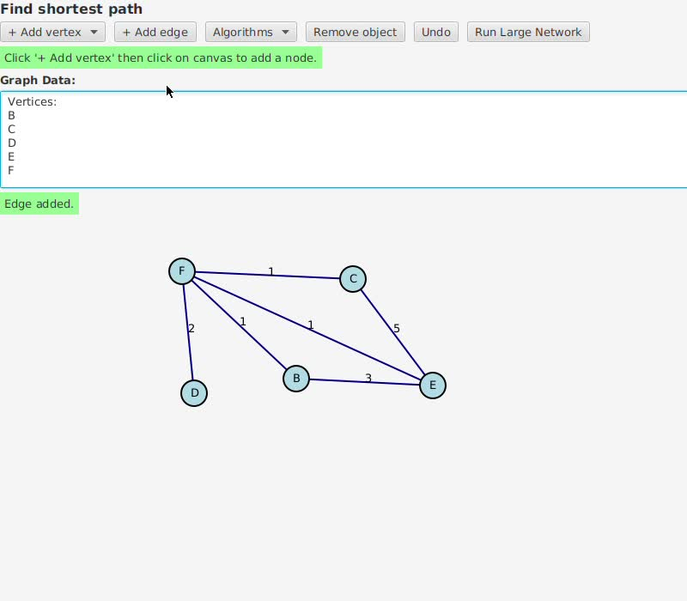
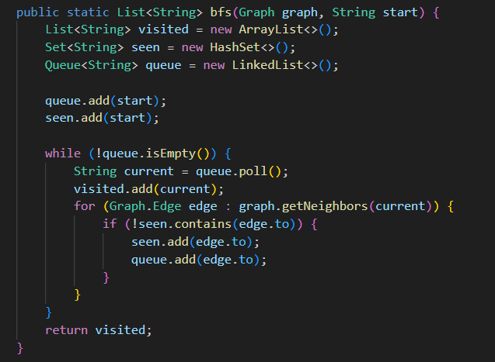
Code Example – BFS
Explanation:
Starts with the initial node, explores all neighbors, then moves to neighbors' neighbors.

Slide 9
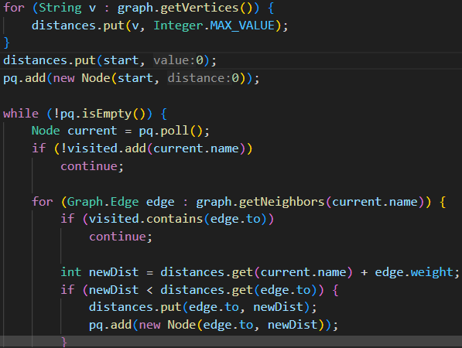
Code Example – Dijkstra
Explanation:
Uses a priority queue to keep track of the shortest paths as it explores the graph

Slide 10
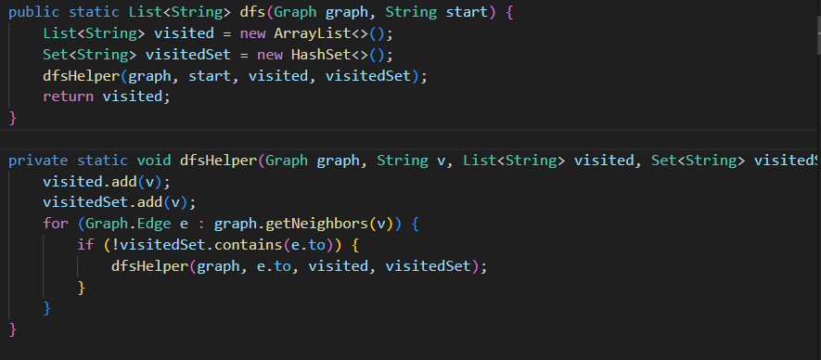
Code Example – DFS
Explanation:
explores a graph by diving deep into one branch before backtracking to explore other branches.

Slide 11
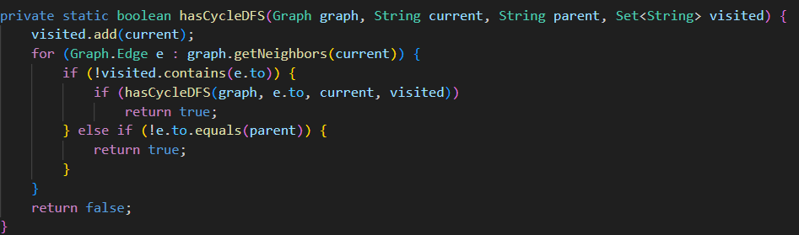
Code Example – Cycle Detection
Explanation:
Cycle Detection checks if a graph has any cycles (paths that loop back to the starting node).

Slide 12
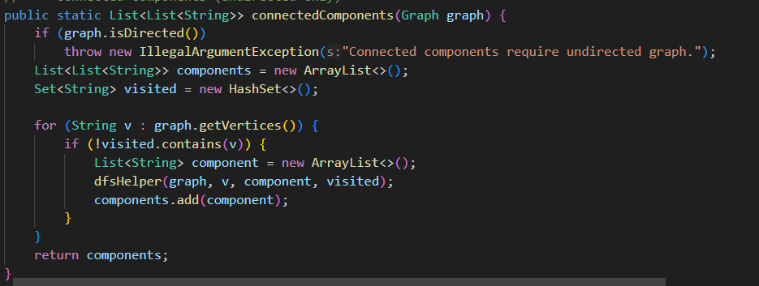
Code Example – Connected Components
Explanation:
Connected Components identifies isolated subgraphs or "clusters" in the graph that are not connected to other parts

Slide 13
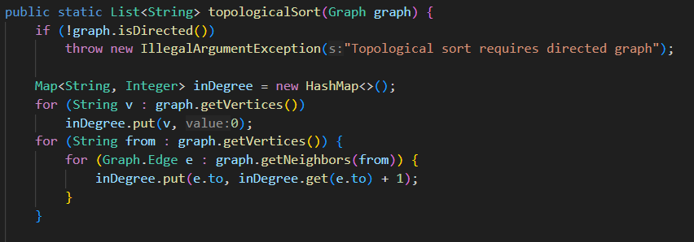
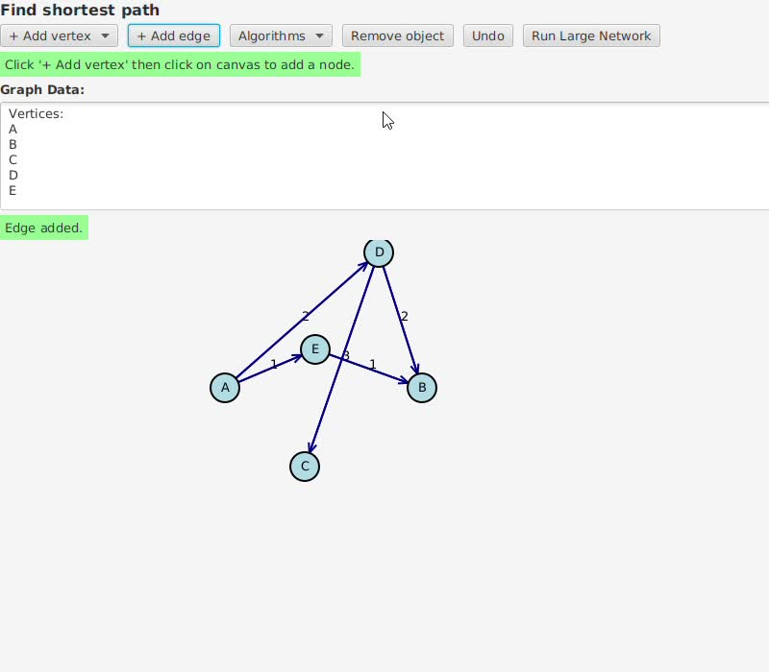
Code Example – Topological Sort
Explanation:
Topological Sort arranges nodes in a directed acyclic graph (DAG) such that each node appears before any node it points to

Slide 14
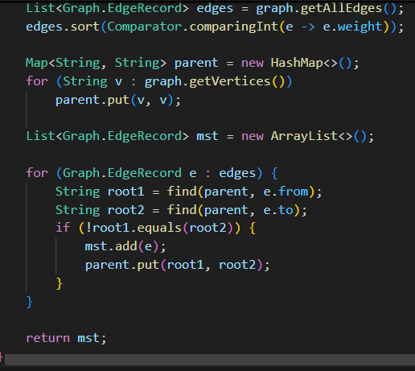
Code Example – Minimum Spanning Tree
Explanation:
Returns the Minimum SpanningTree in an undirected graph

Slide 15
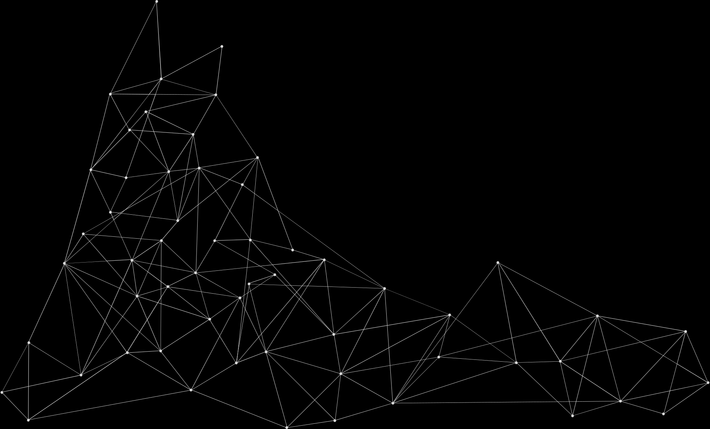
Controller.java
What it Does:
Receives user inputs from GUI.
Runs the corresponding algorithm (like BFS, DFS).
Displays results.
See in Vscode :)

Slide 16
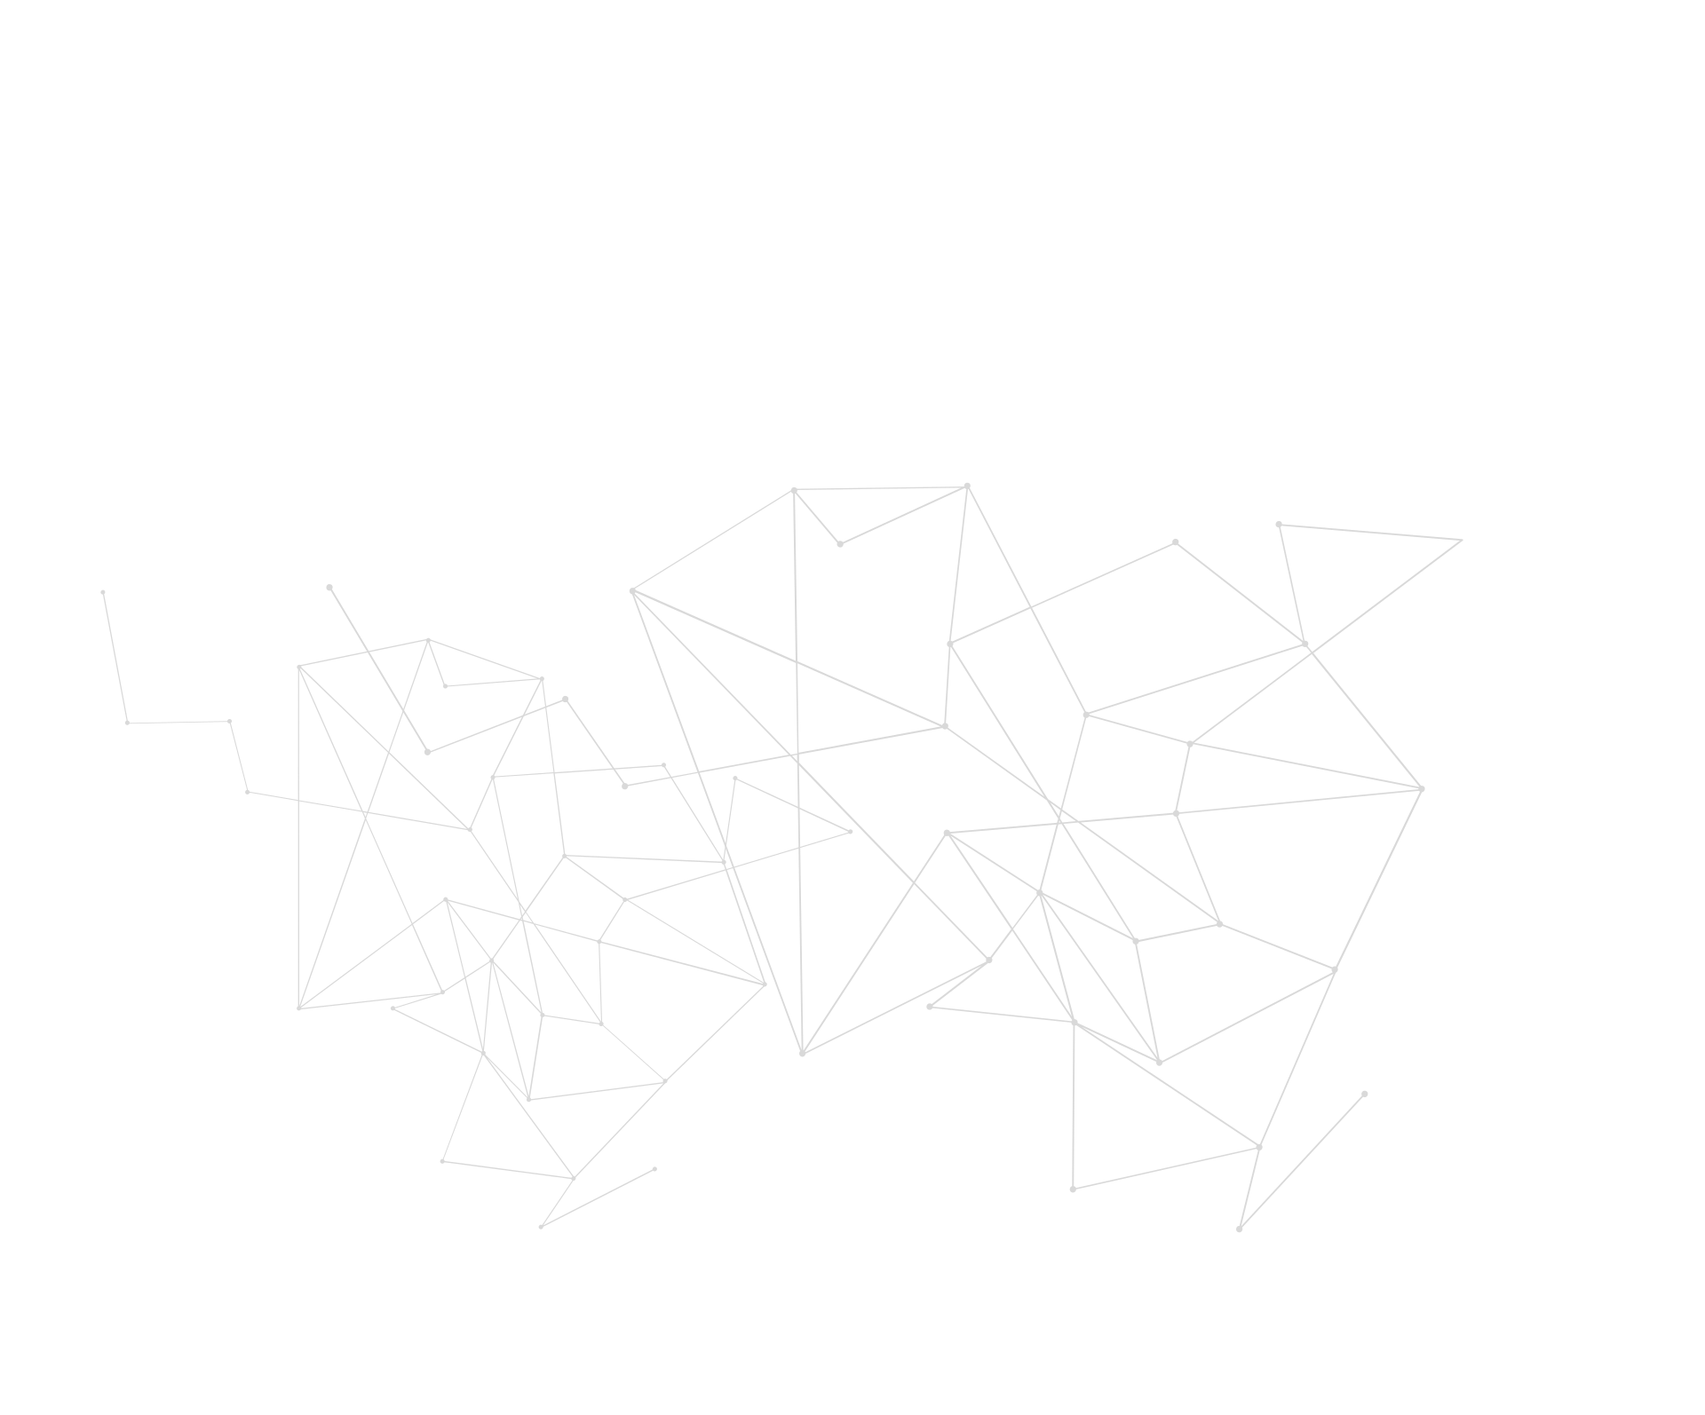
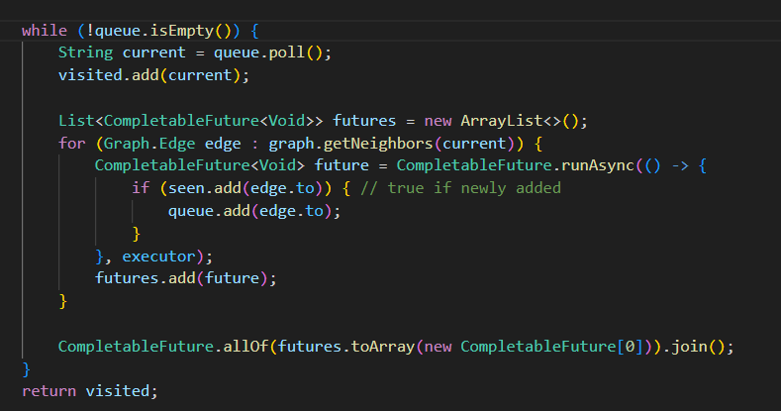
Parallelization Strategy
Parallel Processing: Split the graph and run parts of algorithms simultaneously.
Java Tools:
CompletableFuture: Allows asynchronous tasks.
StructuredTaskScope: Manages multiple parallel tasks.
Goal: Speed up graph processing by parallelizing BFS, DFS, Dijkstra, and others.

Slide 17
Results
Results came as follows:
Sequential Dijkstra sometimes performs better than parallel, especially on small or sparse graphs.
Parallel versions like MST (Kruskal) and Topological Sort show better speedup.
Performance depends on graph structure and start node.
We’re currently implementing a MultiQueue parallel Dijkstra to improve concurrency.
Future work: optimize locking, load balancing, and test on real-world graphs.

